Slide 1
English for
International
Communication

Slide 2
奠基篇 Unit 4
Part 3 簡短對話

Slide 3
奠基篇 Unit 4
題型說明
在 Part 3 中，你會聽到 13 組兩個人或三個人之間的簡短對話，部分對話還會加上圖表。每組對話各有三個問題，共 39 題（測驗中 Q32-Q70）。測驗中對話只能用聽的，但每題組的問題和答案都出現在題本中，且題與題之間會停留約 7～8 秒讓應試者答題。故基本的應試技巧為：充分利用一開始播放 Direction 的時間，先瀏覽第一道題組的三個問題。接著在每段對話開始之前，亦利用答題的間隔時間快速瀏覽該題組的題目及選項，以便推測可能的對話主題。這個部分的題型大多以 Wh- 形式的問句為主，包括人物、地點、談論主題、談話的原因等。

Slide 4
奠基篇 Unit 4
題型分析
題型1 | 與「人物」有關 | A. 問人物身份 B. 問人物間的關係
題型2 | 與「事件」有關 | A. 問主題／目的 B. 問意見或觀感 C. 問行動或做法 D. 問原因
題型3 | 與「細節」有關 | 常見問題包括： • 時間 • 地點 • 物件 • 數字

Slide 5
奠基篇 Unit 4
題型分析
題型4 | 推論題 | 關鍵字： • most likely • probably • might • inferred/implied
題型5 | 考口說語法或句意 | A. 使用口語短句或慣用語，如 No can do. 「沒辦法」、Will do.「我會去做」等 B. 詢問某句話在對話中為何意
題型6 | 加入「圖表」 | 考題用意： 測驗考生整合聽力和閱讀圖表資訊的能力

Slide 6
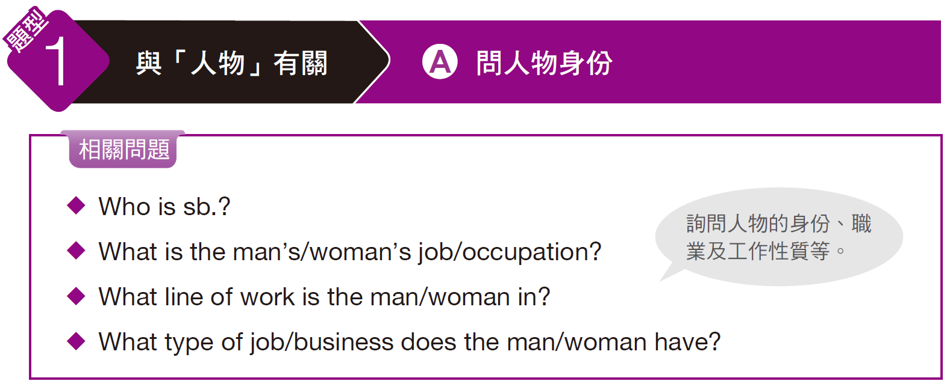
奠基篇 Unit 4

Slide 7

奠基篇 Unit 4
Example
Q: What is the man’s occupation?
(A) Restaurant manager
(B) Estate agent
(C) Travel agent
(D) Hotel clerk
錄音內容
W: Hi, I need to book a room for two nights, February 13 and 14. I need a double room, non-smoking, and preferably with a view.
M: I’m sorry. We don’t have any double rooms available on those days. There’s a convention in town that weekend.
W: Oh, no! I have to meet with a client. Do you have any vacancies at all?
M: Let’s see . . . I have a suite available. It’s a little more expensive, but it has a living room and a kitchen.

Slide 8
奠基篇 Unit 4
解析
由女子說的關鍵字詞 book a room「訂房」、double room「雙人房」、vacancy「空房」等，及男子回應 don’t have any double rooms available「沒有任何空的雙人房了」、have a suite available「還有套房」等關鍵字詞，可判斷出男子的職業為選項 (D) Hotel clerk「飯店櫃台人員」。
中文翻譯
女： 嗨！我需要訂一間房間，要住兩個晚上，時間是二月十三號和十四號。我需要禁煙的雙人房，最好是有景觀的房間。
男： 很抱歉，那幾天都沒有任何空的雙人房了，那個週末鎮上剛好有活動。
女： 喔，不妙！我需要跟一個客戶見面，你們還有其他空房嗎？
男： 我看看……還有一間套房，價位比較貴一點，但裡面有客廳及廚房。

Slide 9
奠基篇 Unit 4
Exercise
Listen to the audio track. Answer the following question about what the speakers say in the conversation.
Q: Who is Dan Ryder?
(A) One of the speakers
(B) The speakers’ manager
(C) A book writer
(D) The man’s favorite author
錄音內容
W: I have here Dan Ryder’s proposal for his next novel. We have to publish this.
M: I’ve seen it, but I’m going to vote to turn it down at today’s meeting. Dan is known for books in the mystery genre. What he’s given us is a romance novel.
W: Yes, but his readers flock to his book signings. They’ll buy anything that carries the “Dan Ryder” name. I’m voting yes. His book is destined to be a blockbuster.
M: I’m sorry; I’m not changing my mind. He’s expanding his horizons, but I’m only interested in publishing his mystery novels.
• genre (n.) 作品之類型 • blockbuster (n.) 非常成功的書或電影
• horizon (n.) 眼界；視野

Slide 10
奠基篇 Unit 4
中文翻譯
女： 我這裡有丹‧萊德下一本小說的提案，我們必須出版這本小說。
男： 我看過了，但我會在今天的會議上投反對票。丹是以懸疑小說出名，但他這次給我們的卻是愛情小說。
女： 沒錯，但他的讀者總是在簽書會蜂擁而至。他們會購買任何帶有「丹‧萊德」這個名字的商品。我投贊成票。他的書一定會大賣。
男： 抱歉，但我不會改變心意。他擴張自己的領域，但我只對出版他的懸疑小說有興趣。

Slide 11
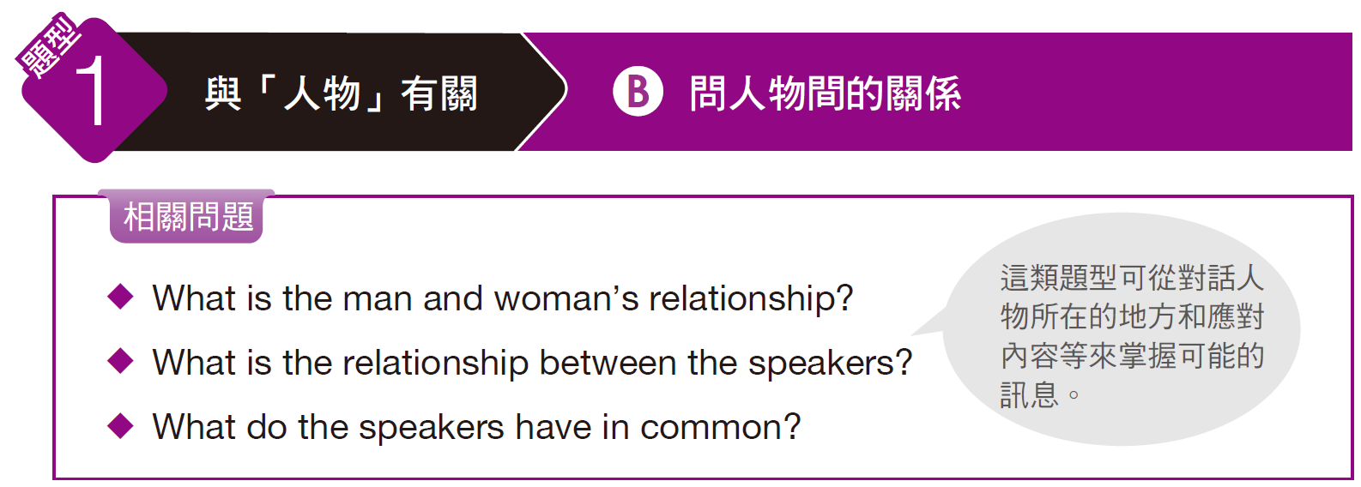
奠基篇 Unit 4

Slide 12
奠基篇 Unit 4
Example
Q: What is the man and woman’s relationship?
(A) They are husband and wife.
(B) They are boyfriend and girlfriend.
(C) They are saleswoman and customer.
(D) They are colleagues.
錄音內容
M: This is my first day working here. Do you know if there are any good restaurants in this area?
W: Yes. I’ve worked here a while and I know several good restaurants nearby. What kind of food do you like?
M: Well, I’m a vegetarian, so I’m hoping to find a vegetarian restaurant.
W: There’s a good Western restaurant right across the street that has vegetarian dishes.

Slide 13
奠基篇 Unit 4
解析
題目問兩人關係，關鍵句為 This is my first day working here.「今天是我第一天上班。」，故答案選 (D)「他們是同事。」
中文翻譯
男：今天是我到這裡上班的第一天。妳知道附近有什麼好吃的
餐廳嗎？
女：知道啊。我在這裡工作一陣子了，所以知道附近幾間不錯
的餐廳。你喜歡吃什麼菜？
男：嗯，我是素食主義者，所以我想要找素食餐廳。
女：這條街對面有一間不錯的西式餐廳，他們有素菜。

Slide 14
奠基篇 Unit 4
Exercise
Listen to the audio track. Answer the following question about what the speakers say in the conversation.
Q: What is the woman’s relationship with the man?
(A) She is the man’s client.
(B) She works for the man.
(C) She is the man’s supervisor.
(D) She is the man’s IT staff.
錄音內容
W: Is this the first time you’ve used our new CRM software? I can help you get started.
M: Oh, thank you. In fact, this is the first time. It looks complicated.
W: Well, it’s good software. It records a customer’s history, contact info, and everything.
M: That will sure make dealing with customers easier. Thanks for the help. I’m lucky to have you for a manager.
  • complicated (adj.) 複雜的

Slide 15
奠基篇 Unit 4
中文翻譯
女： 這是你第一次用我們的CRM軟體嗎？我可以幫忙你上手。
男： 喔，謝謝。事實上，這是我第一次用。它看起來很複雜。
女： 嗯，那是很不錯的軟體。它記錄了客戶歷史、聯絡資料和 所有資訊。
男： 那肯定會使得和客戶往來更簡便。謝謝妳的協助。我真幸
運有妳做我的經理。

Slide 16
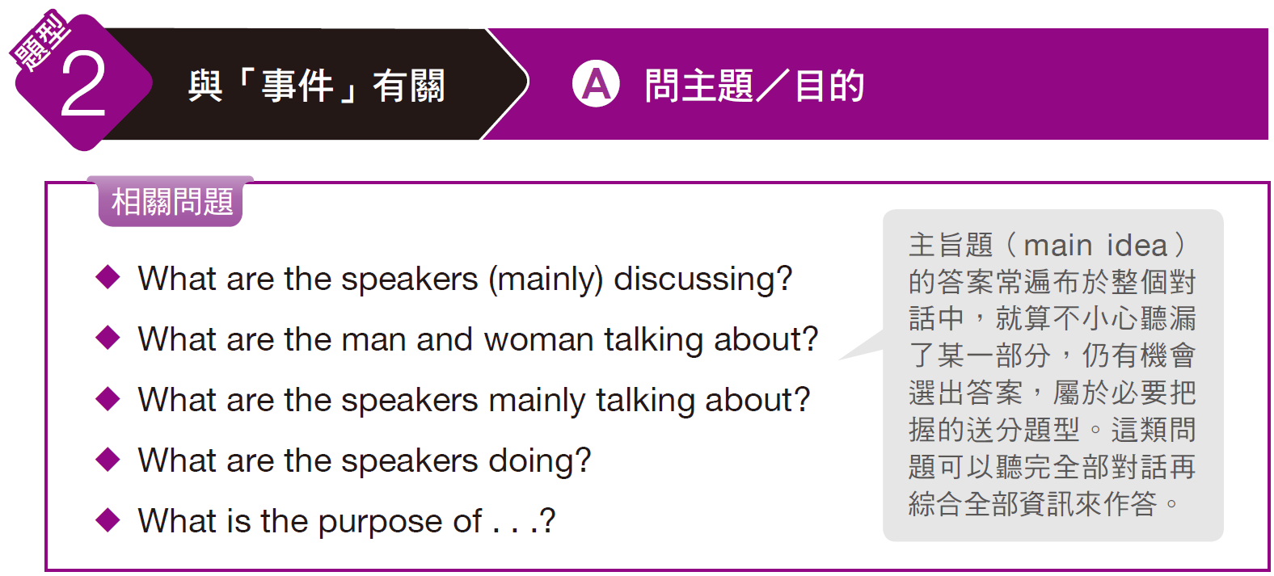
奠基篇 Unit 4

Slide 17
奠基篇 Unit 4
Example
Q: What are the speakers mainly talking about?
(A) The woman’s weight
(B) The man’s parcel
(C) The woman’s flight
(D) The man’s workload
錄音內容
M: How much will it cost to send this package= [parcel] to New York City? I need to get it there by Wednesday morning at the latest.
W: Let me weigh it . . . OK, if you send it by two-day express, it’ll cost 35 dollars and 15 cents.
M: That’s more than I wanted to spend. When will it arrive if I send it by standard shipping?
W: Hmm . . . It might arrive by Wednesday, but not sooner. The only way we can guarantee getting it there on time is sending it by two-day express.

Slide 18
奠基篇 Unit 4
解析
由男子詢問包裹寄送的費用及時間，以及女子回應不同運送方式的價格與時程，可判斷出兩人主要在討論 (B)「男子的包裹」（parcel = package）。
中文翻譯
男： 要把這個包裹寄到紐約市要多少錢？這個包裹最晚星期三早上一定要送到。
女： 我來秤秤看……如果你以限時兩天的快遞寄到紐約的話，需要花 35.15元。
男： 這個價錢超出我的預算，如果我用標準郵遞方式寄件的話，包裹什麼時候會送到？
女： 嗯……最早可能也要等到星期三，兩日限時快遞是唯一我們保證能讓包裹準時送達目的地的方式。

Slide 19
奠基篇 Unit 4
Exercise
Listen to the audio track. Answer the following question about what the speakers say in the conversation.
Q: What are the speakers mainly discussing?
(A) A surprise party
(B) A business plan
(C) An upcoming event
(D) A pair of new shoes
錄音內容
W: A letter from the conference’s planning committee just arrived. The trade show will be moved to next month. It seems there is a problem with the program.
M: I’m not surprised. They did this last year. Last time, they messed up the program’s floor plan so badly, no one knew where to go. Some of our clients complained that they couldn’t find our booth!
W: Whoever arranges these things isn’t doing a good job. I could do better, I’m sure.
M: I certainly wouldn’t want to be in their shoes. Can you imagine all the responsibility that job comes with? They must deal with problems every day.
• committee (n.) 委員會 • mess up 搞砸、弄糟 • booth (n.) 貨攤
• in (one’s) shoes 處於某人的情況

Slide 20
奠基篇 Unit 4
中文翻譯
女： 大會的計畫委員會寄來一封信，貿易展將延至下個月，整個計畫似乎有點問題。
男： 我並不意外。他們去年也是這樣。上次，他們搞砸了展場的樓層規劃，大家都不知道怎麼走，有些客戶抱怨找不到我們的攤位。
女： 不管是誰安排這些事都做得不好，我確信我可以做得更好。
男： 我絕對不想參與這件事，妳能想像這份工作的責任有多大嗎？他們每天都必須處理問題。

Slide 21
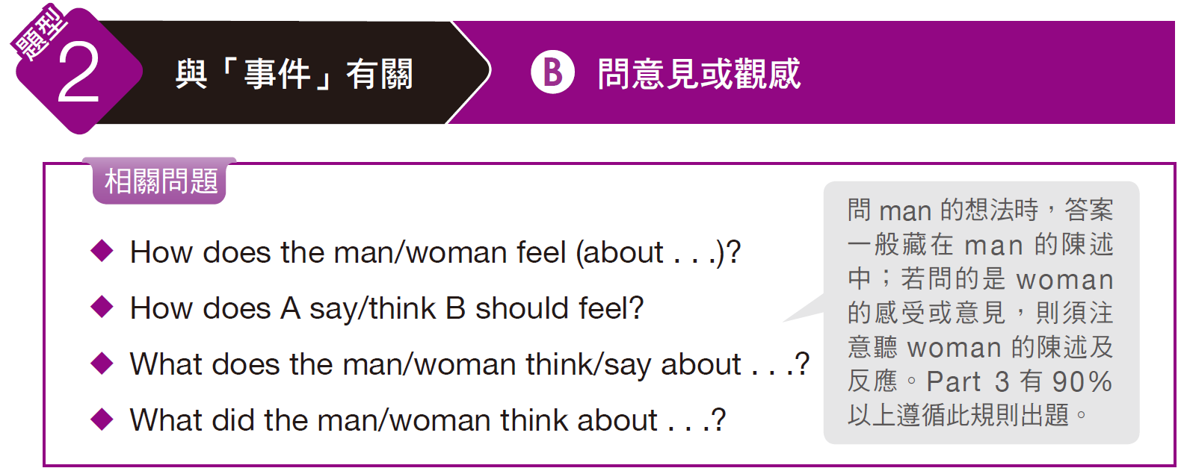
奠基篇 Unit 4

Slide 22
奠基篇 Unit 4
Example
Q: How does the woman feel about the man?
(A) He could be CEO.
(B) He is inexperienced.
(C) He would be a good manager.
(D) He should work in another department.
錄音內容
M: I heard the position of manager is open. I want to be promoted to the position.
W: I’m glad to hear it. Why do you feel you’re qualified to be manager?
M: I know our department and I know the people. I have the experience to manage the department.
W: Well, as your colleague, I will recommend you to our CEO. I think you’re the right person for the job.

Slide 23
奠基篇 Unit 4
解析
男子一開始提到經理的職缺，而解題關鍵句為女子所說：I will recommend you to our CEO. I think you’re the right person for the job.「我會向執行長推薦你，我覺得你是這個職缺的適合人選。」，故答案選 (C)，女子認為「他將會是一位好的經理。」
中文翻譯
男：我聽說有個經理的職缺，我想要晉升這項職位。
女：我很高興聽到你這麼說，為什麼你覺得你能夠勝任？
男：我了解我們的部門和員工，我有足夠的經驗能夠管理這個部門。
女：嗯，身為你的同事，我會向執行長推薦你，我認為你是這個職缺的適合人選。

Slide 24
奠基篇 Unit 4
Exercise
Listen to the audio track. Answer the following question about what the speakers say in the conversation.
Q: What does the woman think about the man’s idea?
(A) She thinks it is unreasonable.
(B) She wants him to refine it.
(C) She thinks it has potential.
(D) She doesn’t think it is good.
錄音內容
W: Good work on today’s brainstorming session. I think you’re really onto something with this idea.
M: Well, it just occurred to me the company should take a different tack. We’ve been selling the same line of pens for years. It’s time that we branch out and take a few risks.
W: And the executives agree. You provided sound evidence and we trust you to make this new product line work.
M: Thanks. I’m excited to be starting something new here. I hope the project is as successful as I projected it to be.
• session (n.) 會議 • tack (n.) 方法、方針 • branch out 擴展業務
• executive (n.) 經理；管理階層 • sound (adj.) 正確的；合理的

Slide 25
奠基篇 Unit 4
中文翻譯
女： 你在今天的腦力激盪會議上表現得很好。我覺得你這個點子真的很有想法。
男： 嗯，我只是想到公司應該採取不同方針，我們多年以來一直銷售同樣的鋼筆產品系列，該是擴展業務和冒一些險的時候了。
女： 主管們也同意。你提供了好的實證，而我們相信你可以讓這條新產品線成功。
男： 謝謝，我對於能夠在這裡展開新計畫非常興奮，希望這個計畫能像我預期的一樣成功。

Slide 26
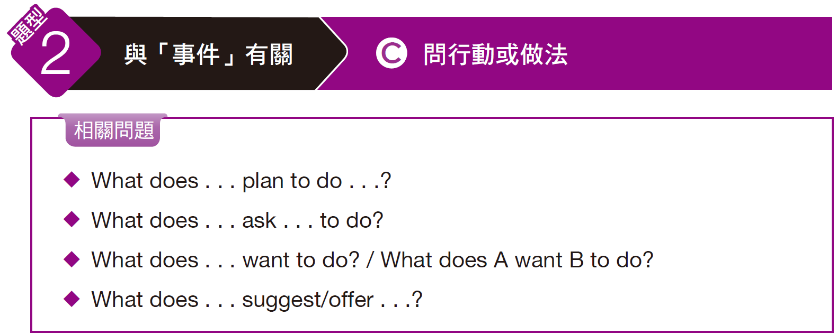
奠基篇 Unit 4

Slide 27
奠基篇 Unit 4
Example
Q: What does the woman want the man to do?
(A) Lodge a complaint
(B) Answer a complaint
(C) Admit to a mistake
(D) Ignore a criticism
錄音內容
W: I heard you weren’t happy with how the bank manager treated us yesterday afternoon. Why don’t you put in a complaint?
M: No thanks. We would run into trouble if I did that. You know that we do a lot of work with the bank, and I’d hate to have a small problem ruin our relationship.
W: Dan, she hasn’t been able to resolve the issue for over three months. If writing a complaint will help fix the problem, it’s worth it.
M: If it’s so worth it, why don’t you do it?

Slide 28
奠基篇 Unit 4
解析
題目問「女子想要男子做什麼？」，由女子說的關鍵句 Why don’t you put in a complaint?「你為什麼不提出客訴呢？」及 If writing a complaint will help fix the problem . . .「如果提出客訴會有助於解決問題……」可知答案選 (A) Lodge a complaint「提出抗議／客訴」，亦常說成 file a complaint。
中文翻譯
女： 我聽說你對於銀行經理昨天下午對待我們的方式深感不悅，你為什麼不提出客訴呢？
男： 不，謝了，如果我真的這麼做的話我們會有麻煩的。妳知道我們很多的工作跟銀行關係密切，我不想要因為一個小問題毀了我們的關係。
女： 丹，已經超過三個月了，她還是無法解決這個問題，如果提出客訴會有助於解決問題，是值得試試看的。
男： 如果真的是這樣，妳怎麼不做呢？

Slide 29
奠基篇 Unit 4
Exercise
Listen to the audio track. Answer the following question about what the speakers say in the conversation.
Q: What does the man suggest the woman do?
(A) Buy the item from him
(B) Sell the item to him
(C) Buy the item at another location
(D) Continue to bargain with him on the price
錄音內容
W: Are you kidding? That price is outrageous. You said you were coming to our meeting prepared to sell. The price you give sounds like you don’t want to give up ownership.
M: The price is high, but not unreasonable. Not when you consider the condition the coin is in.
W: I’ve seen the same piece going for half as much at other places.
M: Well, I suggest you go there then. You’ve seen my collection and heard my prices. You know where to find me if you wish to reconsider.
• outrageous (adj.) 令人驚訝的；無法容忍的 • ownership (n.) 所有權

Slide 30
奠基篇 Unit 4
中文翻譯
女： 你在開玩笑嗎？那個價錢實在太離譜了。你說你準備好在我們會面時要賣。你提出的價位讓人覺得你好像還不想放棄所有權。
男： 這樣的價位是很高，但很合理。想想這個錢幣的狀態，妳就不會覺得價位高了。
女： 我在別的地方看到相同的東西只要一半的價格。
男： 嗯，那我建議妳去那邊買。妳已經看過我的收藏也知道價錢了，如果妳想重新考慮的話，妳知道要怎麼與我聯繫。

Slide 31
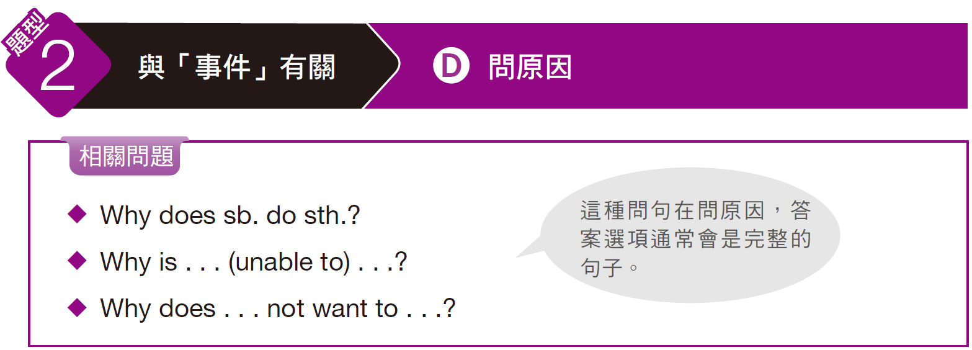
奠基篇 Unit 4

Slide 32
奠基篇 Unit 4
Example
Q: Why is the man unable to do the presentation?
(A) He has little knowledge of the subject.
(B) He is preparing a workbook for employees.
(C) He is doing the books for accounting.
(D) He has previously scheduled appointments.
錄音內容
W: We’re still short on speakers. I have an idea; why don’t you do the presentation?
M: I can’t. I’m booked for next week, remember? I told you about this at the meeting. Next week I’m on my way to Atlanta to meet with Gregory.
W: Come on, I can’t look to Paul to do it. Last time, he bored the audience with corny jokes that no one laughed at. He’s not nearly as good as you are.
M: I really can’t. If Paul is the only option left, you’ll just have to make do.

Slide 33
奠基篇 Unit 4
解析
題目問「男子為何無法做簡報？」，由男子說的關鍵句 I’m booked for next week.「我下個星期都已排滿了。」及 I’m on my way to Atlanta to meet with Gregory.「我要去亞特蘭大與魁格利會面。」可知答案選 (D)「他已事先安排會議。」
中文翻譯
女： 我們現在還缺講者，我有個點子，不妨由你來做簡報吧！
男： 我沒辦法，我下星期都排滿了，記得嗎？我在會議中已經告訴過妳，我下星期要去亞特蘭大與魁格利會面。
女： 拜託，我不能指望讓保羅做簡報，上一次，他講冷笑話讓聽眾覺得很無趣，根本就沒有人笑，你比他好太多了。
男： 我真的沒辦法，如果保羅是唯一最後的選擇，妳也只能讓他去做了。

Slide 34
奠基篇 Unit 4
Exercise
Listen to the audio track. Answer the following question about what the speakers say in the conversation.
Q: Why does the man not want to advertise on TV or in print?
(A) TV advertising is too expensive.
(B) Young people spend their time on computers.
(C) Their type of fashion doesn’t sell on TV or in print.
(D) Young people never pay attention.
錄音內容
W: We need a better advertising plan for our new clothing line. We need to target a younger market.
M: I agree. Younger people are much more interested in this type of fashion.
W: What’s the best way to reach a younger audience? On TV or in print?
M: Neither. We need to advertise on the Internet, and with video, too. That’s what young people are paying attention to these days.
• target (v.)把……作為目標（或對象） • pay attention 注意；關心

Slide 35
奠基篇 Unit 4
中文翻譯
女： 針對新的系列服飾，我們需要更好的廣告計畫。我們要把目標放在年輕市場。
男： 我同意，年輕人對這類的流行風格比較感興趣。
女： 哪種方法才能最有效地將商品推銷給年輕觀眾？電視或出版刊物？
男： 都不行，我們需要在網路上打廣告，而且要搭配影片。那才是近年來年輕人會注意的地方。

Slide 36
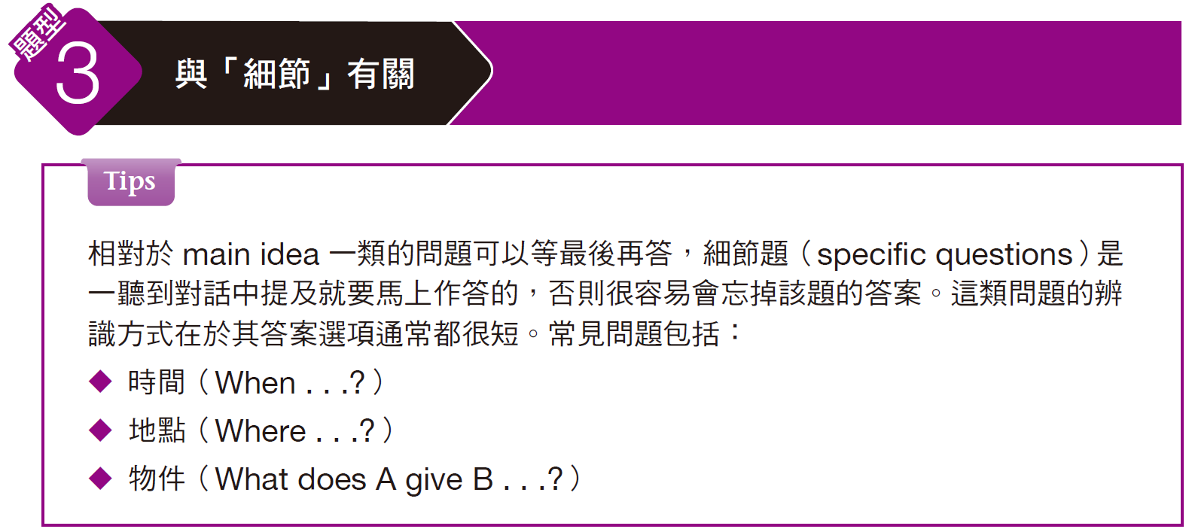
奠基篇 Unit 4

Slide 37
奠基篇 Unit 4
Example
Q: When do the speakers plan to meet?
(A) Monday
(B) Tuesday
(C) Thursday
(D) Today at noon
錄音內容
M: I have to cancel our meeting this afternoon. I have to leave early to pick my son up from school.
W: Oh, I was looking forward to hearing about your sales plans. I’m out of town Monday. Can we reschedule for Tuesday?
M: I’m afraid I’ll be busy then. Will Thursday work for you?
W: Sure, that’ll be great. How about meeting over lunch?

Slide 38
奠基篇 Unit 4
解析
題目問 When，且答案都很簡短，是一看到題目就要邊聽對話邊找答案的細節題。此題問「這兩個人打算什麼時候會面？」，由男子所說 Will Thursday work for you?「星期四妳可以嗎？」及女子回答 Sure, that’ll be great. How about meeting over lunch?「當然，那個時間很好。邊吃午飯邊開會如何？」可知答案選 (C)。
中文翻譯
男： 我必須把今天下午的會議取消，我得提早離開去學校接我兒子。
女： 喔，我本來很期待聽你的銷售計畫，我星期一要出城，可以重新安排星期二的時間嗎？
男： 那天恐怕我也會很忙，星期四妳可以嗎？
女： 當然，那個時間很好。邊吃午飯邊開會如何？

Slide 39
奠基篇 Unit 4
Exercise
Listen to the audio track. Answer the following question about what the speakers say in the conversation.
Q: Where is the laptop made?
(A) Japan
(B) Taiwan
(C) China
(D) Canada
錄音內容
M: Excuse me. The AC adapter for my laptop is broken. I’m wondering whether I could get a replacement here.
W: I’m afraid we don’t stock that model. It’s only available in Canada. I assume that’s where you bought it.
M: That’s right. But the laptop is manufactured by a Taiwanese company, here in China.
W: Sure, but it’s for export only and we don’t have any spares. Let me check with my manager and see if we can order one for you.
• AC adapter 變壓器 • assume (v.) 假定
• manufacture (v.) 製造、加工 • spare (n.) 備用品

Slide 40
奠基篇 Unit 4
中文翻譯
男： 不好意思，我筆記型電腦的變壓器壞掉了，想請問是不是可以在這裡換一個新的？
女： 我想我們沒有進那種型號，那只有在加拿大才買得到，我想你應該也是在那裡買的。
男： 沒錯，但這台筆電是中國這裡的一家台灣公司生產的。
女： 對，但只針對出口，而且我們沒有多的備用品。我和經理確認一下，看看能不能幫你訂貨。

Slide 41
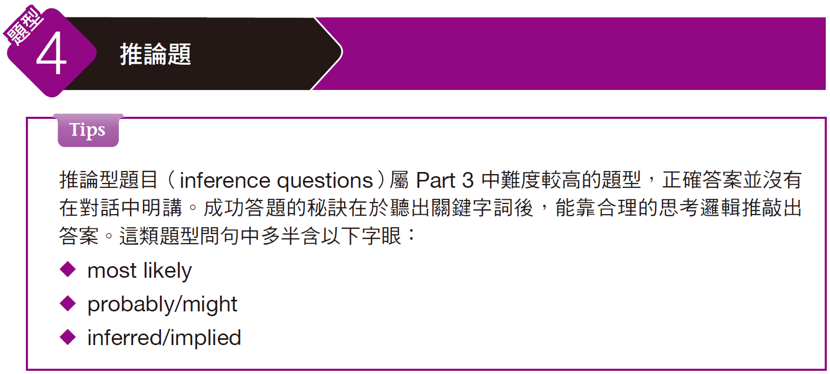
奠基篇 Unit 4

Slide 42
奠基篇 Unit 4
Example
Q: Where does the woman most likely work?
(A) Telephone company
(B) Stock exchange
(C) Supermarket
(D) Bank
錄音內容
M: I’m calling about your telephone services. How do I access my account?
W: Just call the bank, key in your PIN number and you’ll hear the menu options.
M: Can I trade stocks and bonds over the phone?
W: I’m afraid you’ll need a special account for that. But you can check your balance, pay bills, order statements, and transfer money.

Slide 43
奠基篇 Unit 4
解析
由題目中的 most likely 字眼可知此為推論題型。題目問「女子可能在哪裡工作？」，由女子所說 Just call the bank, key in your PIN number . . .「只要打電話到銀行，輸入您的密碼……」以及 special account「特殊帳戶」、check your balance「查看結餘」、pay bills「支付帳單」、order statements「索取（銀行）對帳單」和 transfer money「轉帳」等關鍵字詞可推知女子是在銀行工作。
中文翻譯
男：我打來是要詢問電話客服，我要如何進入我的帳戶。
女：只要打電話到銀行，輸入您的密碼就能聽到選單了。
男：我可以透過電話交易股票和債券嗎？
女：您需要特殊帳戶才可以。但您可以查看結餘、支付帳單、索取銀行對帳單和轉帳。

Slide 44
奠基篇 Unit 4
Exercise
Listen to the audio track. Answer the following question about what the speakers say in the conversation.
Q: What industry might the speakers work in?
(A) Furniture
(B) Clothing
(C) Removals
(D) Health care
錄音內容
M: Before I start, I suggest we go round the table to get all of your input.
W: I think we’re focusing too much on our youth market at the expense of older consumers.
M: Interesting. What can we do to address that?
W: We need to expand our summer range to include more styles suited to mature shoppers.
• input (n.) 意見 • address (v.) 對付；處理

Slide 45
奠基篇 Unit 4
中文翻譯
男： 在我們開始之前，我建議在座的各位先依序發表自己的意見。
女： 我認為我們太重視年輕市場而犧牲掉成年市場。
男： 有趣的見解，我們要怎麼對付這項問題？
女： 我們需要擴大我們的夏季系列，讓商品有更多適合成年顧客的風格。

Slide 46
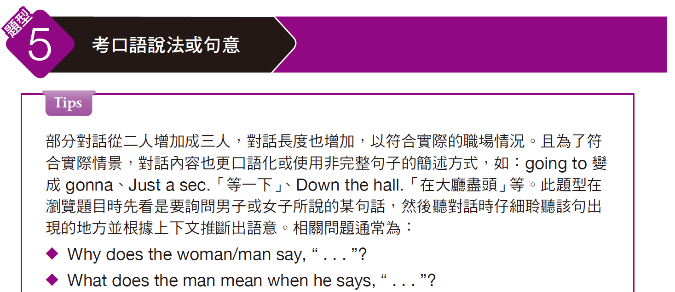
奠基篇 Unit 4

Slide 47
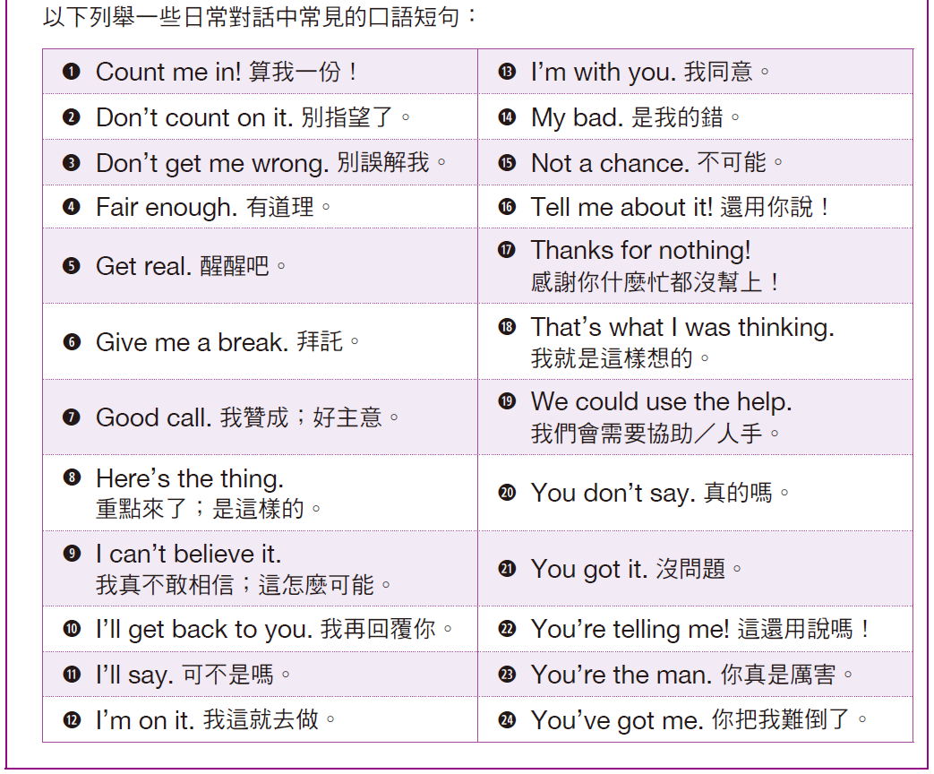
奠基篇 Unit 4

Slide 48
奠基篇 Unit 4
Example
Q: Why does the first male speaker say, “No kidding”?
(A) He wants the woman to be more serious.
(B) He agrees with the woman’s statement.
(C) He is offended by what the woman said.
(D) He is worried he might offend the woman.

Slide 49
奠基篇 Unit 4
錄音內容
W: I guess it’s a good problem to have, needing to decide between three star candidates. You’ve both met the interviewees. I’d like to hear your opinions before I make a decision since you’ll be working with whoever comes onboard. It’s a tough choice.
MA: No kidding. Mr. Smith impressed me quite a bit. Well, they all did, but I think he might have the most relevant experience.
W: I can see that. But Ms. Hanson is much younger and might have more potential. I didn’t care for the other one.
MB: Precisely. I think she’d be a quick learner, and she seems passionate.
W: Is that something you’re willing to help with?
MA: Well, a younger team member may lack some experience, but we could train her to do things the right way and avoid any bad habits.
MB: I agree. You remember the guy who got fired? He was convinced he knew how to do everything.
W: Point taken. So it sounds like we’ve reached a decision.

Slide 50
奠基篇 Unit 4
解析
對話一開始女子提到須從三位有潛力的應試者中選出一位，且想聽聽其他兩位男士的意見，因為他們之後會跟這位新進員工共事。接著又說It’s a tough choice.「要做決定很難」。男子此時回應女子No kidding.，且後面表達出自己對應試者的看法，表示這幾位都令他印象深刻，故知男子說的No kidding.是附和女子說的It’ s a tough choice.，答案選(B)「他同意女子的陳述。」

Slide 51
奠基篇 Unit 4
中文翻譯
女： 我想得從這三位優秀候選人中做出決定是個很好的難題。你們倆都見過來面試的人。我想在做決定前先聽聽你們的意見，因為無論到職的是誰，你們都會和他／她共事。要做決定很難。
男A： 真的是這樣。史密斯先生讓我印象很深刻。嗯，他們皆是如此，但我覺得他也許有最多的相關經驗。
女： 我看得出來。但韓森小姐年輕多了，也許更有潛力。我不太喜歡另一個人。
男B： 確實如此。我覺得她學東西應該很快，而且似乎很有熱情。
女： 你們會願意幫忙她進入狀況嗎？
男A： 這個嘛，較年輕的團隊成員也許會缺乏一些經驗，但我們可以訓練她正確的做事方式，並避免任何壞習慣。
男B： 我同意。你還記得被開除的那個傢伙嗎？他認為他知道每件事要怎麼做。
女：你說得對。所以聽起來我們已做出決定了。

Slide 52
奠基篇 Unit 4
Exercise
Listen to the audio track. Answer the following question about what the speakers say in the conversation.
Q: What does the woman mean when she says, “I can’t take it anymore”?
(A) The pain is too severe.
(B) The medicine is making her feel worse.
(C) She wants to find another doctor.
(D) It’s the wrong medication.

Slide 53
奠基篇 Unit 4
錄音內容
W: Hi. I was wondering if you could give me a suggestion. I’ve been having horrible headaches, and my eyes are very sore.
MA: Well, you might try a standard headache medication.
MB: She’s been taking some, but it’s just not working.
MA: I see. Well, we have some stronger medication here, but it might make you a little sleepy. Do you have to drive during the day?
W: No, but I have our kids to take care of.
MB: I’ve told her she needs to go see a doctor because I think it’s more serious. I could barely convince her to come here!
MA: Well, if you’ve tried other medications and they aren’t helping, you might want to go have an exam.
W: I guess I should. //I can’t take it anymore.// Would you recommend anyone in particular?
MA: Let me go find his business card.
• headache (n.) 頭痛 • medication (n.) 藥物
• barely (adv.) 幾乎沒有 • recommend (v.) 推薦

Slide 54
奠基篇 Unit 4
中文翻譯
女： 嗨。我在想你可不可以給我點建議。我的頭一直很痛，而且眼睛很酸。
男A： 嗯，妳也許可以試試一般常用的頭痛藥物。
男B： 她一直有在吃，但就是沒用。
男A： 我瞭解了。那麼，我們這裡有藥效更強的藥，但這會讓妳有點想睡覺。妳白天得開車嗎？
女： 不用，但我得顧小孩。
男B： 我已經告訴她需要去看醫生，因為我覺得情況更嚴重了。我差點無法說服她來這裡！
男A： 這個嘛，如果妳已試過其他藥物但都沒用，那妳可能需要做檢查。
女： 我想我應該需要。我再也受不了了。你有特別推薦哪個醫生嗎？
男A： 讓我去找一下他的名片。

Slide 55
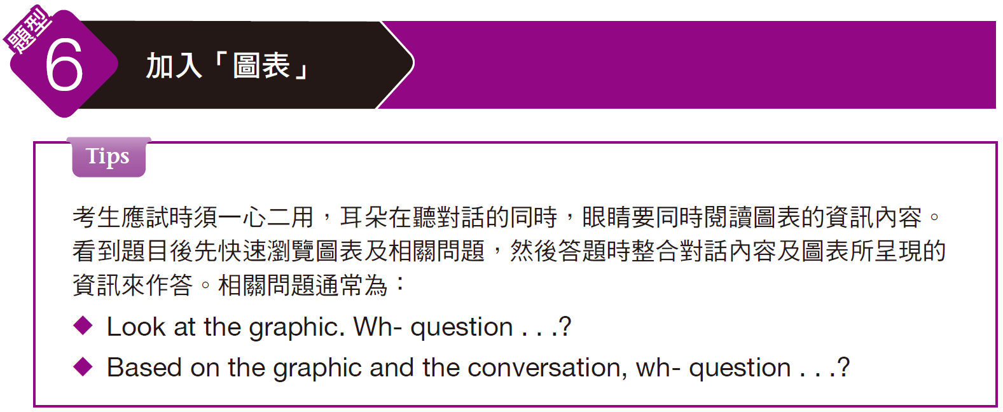
奠基篇 Unit 4

Slide 56
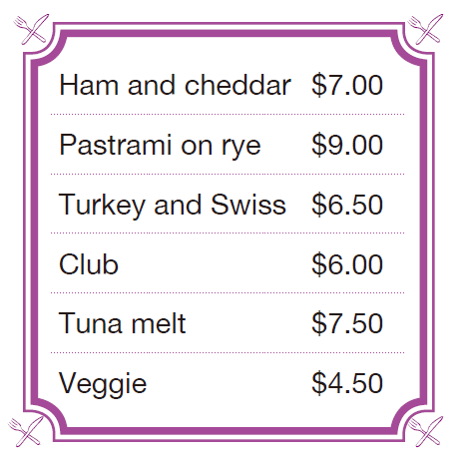
奠基篇 Unit 4
Example
Q: Look at the graphic. Which is the cheapest item on the menu that the woman can buy if she also orders a soup?
(A) Ham and cheddar
(B) Turkey and Swiss
(C) Club
(D) Veggie
錄音內容
W: Hi, what would you recommend for a quick lunch?
M: Well, we’re known for our pizza, but we make it all fresh, so it has to bake.
W: Yeah, I need to take it to go, too. What about one of the sandwiches?
M: We could do any sandwich and add a soup for an additional $3.
W: Well, can you believe it? I only have $10. Short on time and money!
M: No problem. You can get a soup with one of the sandwiches for less than that. Oh, and by the way, the veggie sandwich sold out.
W: OK, I’ll have the Turkey and Swiss with the soup. That’ll have to do.

Slide 57
奠基篇 Unit 4
解析
本題須整合對話及圖表資訊。題目問若女子也要買湯的話，菜單中哪一個是她所能購買最便宜的品項。對話中男子說We could do any sandwich and add a soup for an additional $3.「任何三明治再加三美元即可加購湯品。」而女子提到自己身上只有十美元。男子後來又說 . . . the veggie sandwich sold out.「蔬食三明治已賣完」。對照菜單中最便宜的品項是四點五美元的Veggie「蔬食三明治」，但因已售完而不可選；第二便宜的品項為六美元的Club「總匯三明治」，且加上三美元不會超過十美元，故(C)為正確答案。

Slide 58
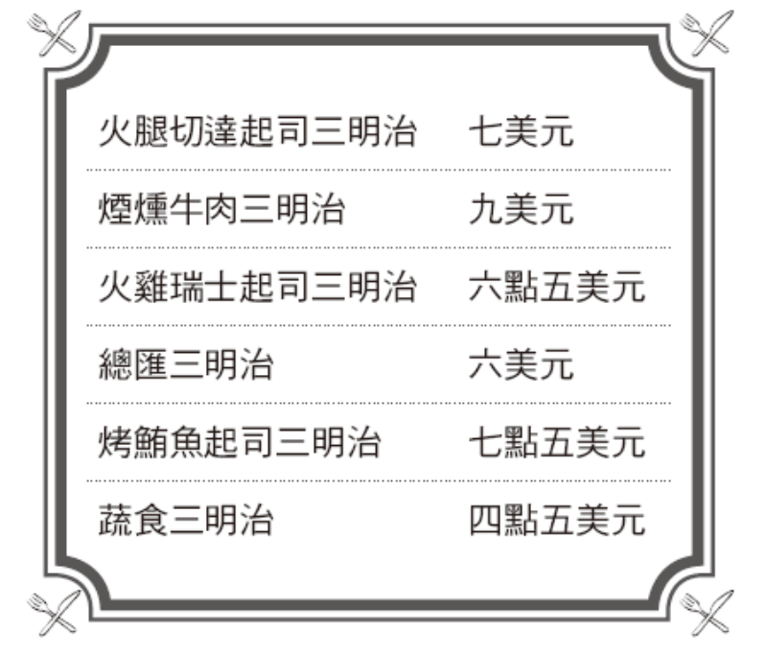
奠基篇 Unit 4
中文翻譯
女： 嗨，若要很快地吃頓午餐，你會推薦什麼？
男： 這個嘛，我們的披薩很有名，但我們都是新鮮現做，所以得烤一下。
女： 是喔，而且我也需要外帶。那些三明治如何呢？
男： 任何三明治再加三美元即可加購湯品。
女： 嗯，你能相信嗎？我身上只有十美元。我的時間和錢都不夠！
男： 沒問題。妳不花超過那些錢就能買一份三明治和湯品。噢，對了，蔬食三明治已經賣完了。
女： 好的，我要一份火雞瑞士起司三明治和一份湯品。這樣就好。

Slide 59
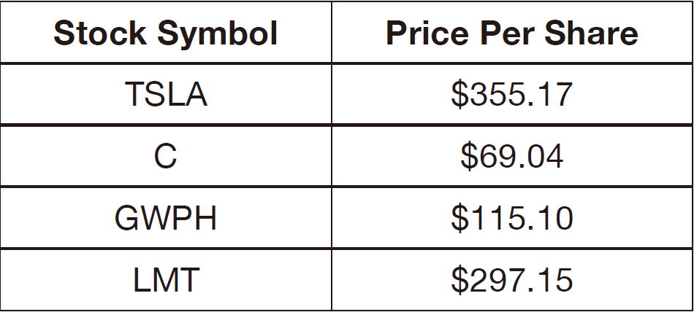
奠基篇 Unit 4
Exercise
Listen to the audio track. Answer the following question about what the speakers say in the conversation.
Q1: Look at the graphic. How much is the woman going to spend on the stock purchase?
(A) $355.17
(B) $3,551,700
(C) $155.10
(D) $1,151,000

Slide 60
奠基篇 Unit 4
錄音內容
W: What are the numbers looking like today?
M: Eh, pretty standard. There aren’t any real surprises so far. TSLA is still trending up, and investors remain skeptical.
W: I see, what about GWPH? Are they still bouncing around the $100.00 range?
M: Yeah, I think that is because they have yet to announce FDA approval of their new drug. The company is still waiting for final approval.
W: I heard that the drug is sure to be approved; it’s only a matter of time. Let’s put in a buy order for ten thousand shares.
M: That sounds aggressive but logical. I’ll get right on it.
• trend (v.) 趨向 • skeptical (adj.) 懷疑的
• bounce (v.) 彈跳 • aggressive (adj.) 激進的；積極的

Slide 61
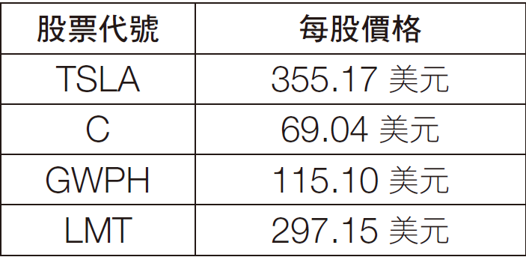
奠基篇 Unit 4
中文翻譯
女： 今天數字看起來如何？
男： 嗯，滿一般的。目前沒什麼真正的驚喜。TSLA仍呈上升的趨勢，而投資人仍抱持著懷疑的態度。
女： 我瞭解了，那GWPH呢？它們仍在一百美元上下震盪嗎？
男： 對，我想那是因為他們還沒公布食品藥物管理局的新藥許可。該公司還在等待最後的許可。
女： 我聽說那款藥確定會獲得許可；這只是時間的問題。我們買進一萬股吧。
男： 那聽起來很大膽但很合理。我馬上去買。

Slide 62
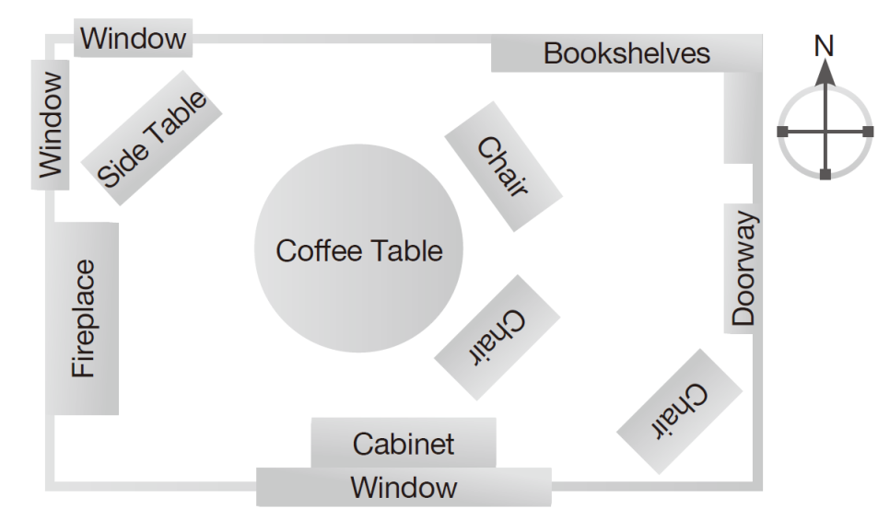
奠基篇 Unit 4
Q2: Look at the graphic. Where will the woman most likely put the plants?
(A) On top of the cabinet
(B) On the side table
(C) On the bookshelves
(D) On top of the coffee table

Slide 63
奠基篇 Unit 4
錄音內容
W: Hi, I’m looking for an easy indoor plant. I’m told caring for plants is relaxing, but it hasn’t been so far.
M: Did you have anything in mind? We have some beautiful flowering plants.
W: Well, that’s not really what I had in mind. Anything good for beginners? Apparently I can’t keep anything alive, but here I am trying again.
M: Well, cacti are easy, but require lots of light.
W: Nope. I’ve got a very curious kitten at home, and I want something . . . prettier that can also take less sun.
M: How about this one? It’s good in a north-or west-facing window, but away from a south-facing window. Water it weekly.
W: Oh, that’s beautiful. Actually, I think I’ll take two!

Slide 64
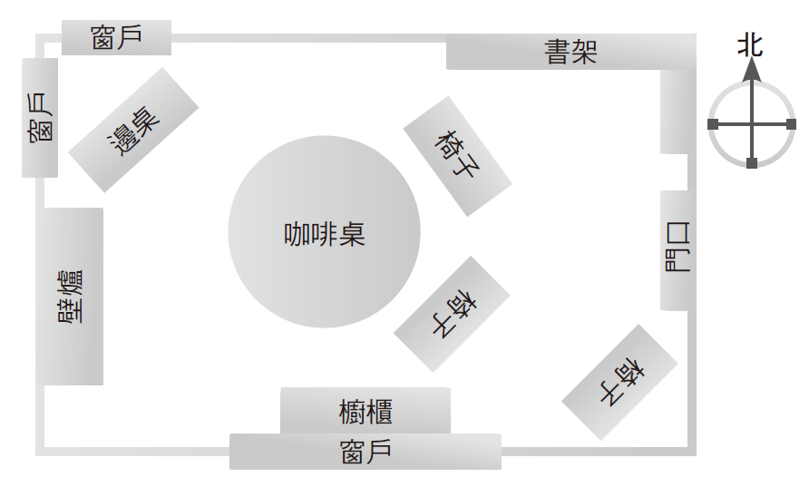
奠基篇 Unit 4
中文翻譯
女： 嗨，我在找容易照顧的室內植物。我聽說照顧植物可以讓人覺得很放鬆，但到目前為止並非如此。
男： 妳已經有什麼想法了嗎？我們有一些美麗的開花植物。
女： 嗯，那不是我想要的。有什麼是適合入門者的嗎？ 顯然我無法讓任何植物存活下來，但我還想再試一次。
男： 嗯，仙人掌很容易栽種，但會需要大量光線。
女： 不行。我家裡有一隻充滿好奇心的貓咪，我想要……比較漂亮又不用太多陽光的。
男： 那這株如何？它適合放在面北或面西的窗邊，但要遠離面向南邊的窗戶。每週澆水即可。
女： 喔，那很漂亮。事實上，我想我要買兩株！

Slide 65
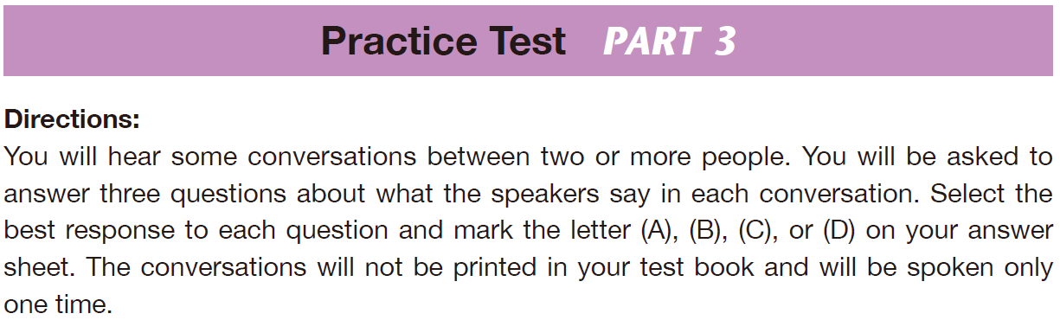
奠基篇 Unit 4

Slide 66
奠基篇 Unit 4
C
B
B
1. What is the woman surprised about?
(A) The low cost of electricity
(B) The employees’ salaries
(C) The high power bill
(D) The cold temperatures
2. Where do these people most likely work?
(A) At a manufacturing plant
(B) At company headquarters
(C) At a retail outlet
(D) At a luxury resort
3. What does the man tell the woman they can’t do?
(A) Use more electricity
(B) Use less electricity
(C) Spend more on power
(D) Keep the employees happy

Slide 67
奠基篇 Unit 4
Audio Transcripts
Questions 1-3 refer to the following conversation.
W: Wow, look at our office’s power bill. It’s more than double what it usually is. How can that be?
M: Well, we’ve been running the heaters a lot this month. It’s been cold. This could turn out to be the coldest winter in twenty years.
W: Well, we have to cut back. With the recent downturn in the economy, we can’t waste so much money on electricity.
M: //We don’t have a choice.// Office workers aren’t as efficient when they’re cold. We need healthy and happy employees if we want a successful company.
• power bill 電費帳單 • heater (n.) 暖氣
• cut back 減少 • electricity (n.) 電力

Slide 68
奠基篇 Unit 4
中文翻譯
女： 哇，看看我們公司的電費帳單，竟然超出平常的兩倍！怎麼會這樣呢？
男： 噢，因為我們這個月一直開著暖氣機。最近很冷，這大概是二十年來最冷的冬天。
女： 嗯，我們得減少開銷。近來經濟不景氣，我們不能浪費這麼多錢在電費上。
男： 我們別無選擇。辦公室員工覺得冷的時候，工作起來就效率不

Slide 69
奠基篇 Unit 4
A
B
B
4. What does the man most likely show the woman?
(A) A brochure
(B) A fax
(C) An ink cartridge
(D) A commercial
5. What does the man want the woman to do?
(A) Buy a three-in-one copier
(B) Give him advice
(C) Save money
(D) Stop buying so many ink cartridges
6. Why does the man not want to buy separate machines?
(A) The office doesn’t have enough space.
(B) He thinks that would be more costly.
(C) He thinks it would be easier.
(D) He likes the color of the printer in the ad.

Slide 70
奠基篇 Unit 4
Audio Transcripts
Questions 4-6 refer to the following conversation.
M: Can you help me choose a new printer for the office? Here’s an ad for one that also makes copies and sends faxes.
W: It would be better to buy a dedicated laser printer, a fax machine and a copy machine. It would be cheaper in the long run.
M: I don’t understand. Isn’t buying one machine cheaper than buying three separate machines? I want to save money.
W: We all want to save money. However, we have to think about long-term savings. These cheap three-in-one printers go through ink really fast. We’d end up spending a lot more buying ink cartridges.
• dedicated (adj.)【電腦】專用的 • ink cartridge 墨水匣

Slide 71
奠基篇 Unit 4
中文翻譯
男： 妳可以幫我為公司選一台新的印表機嗎？廣告上說這台印表機還可以影印和傳真。
女： 分別買專用的雷射印表機、傳真機和影印機會比較好，長遠來說，這樣也比較便宜。
男： 我不懂，買一台機器不是應該比買三台機器便宜嗎？我想要省錢。
女： 大家都想省錢，不過，我們必須想想長期的省錢辦法。這種便宜的三合一事務機墨水消耗速度非常快，所以最後可能得花更多錢買墨水匣。

Slide 72
奠基篇 Unit 4
B
D
C
7. What are the speakers mainly talking about?
(A) Whether to paint the office
(B) What color to paint the office
(C) How often to paint the office
(D) The difference between red and white
8. What does the man say about the color blue?
(A) Blue makes people uncomfortable.
(B) Some people won’t like blue.
(C) Blue is the color of the sky.
(D) Blue makes people comfortable.
9. What kind of painting company does the woman want to hire?
(A) A large and efficient one
(B) A fast and cheap one
(C) A respectable and honest one
(D) A local and friendly one

Slide 73
奠基篇 Unit 4
Audio Transcripts
Questions 7-9 refer to the following conversation.
W: I’m having trouble making up my mind. What color do you think we should paint the office, white with a pink tint or a blue tint?
M: Oh, definitely a blue tint. The color blue makes people feel comfortable, and that’s important for employees and visitors.
W: OK. Get at least four painters to come in and give us a cost estimate. Make sure they are all from reputable companies, though.
M: Good idea. There are some untrustworthy companies out there. And I won’t pick the cheapest or the most expensive.
• tint (n.) 色調 • estimate (n.) 估價
• reputable (adj.) 聲譽好的 • untrustworthy (adj.) 不可信賴的；靠不住的

Slide 74
奠基篇 Unit 4
中文翻譯
女： 我真的很難做決定。你覺得辦公室要漆成什麼顏色，粉紅色調還是藍色系？
男： 噢，當然是藍色系。藍色讓人們覺得舒服，對員工和訪客來說這非常重要。
女： 好的，至少請四位油漆工人過來，並給我們估價表。不過，要確定他們都來自信譽良好的公司。
男： 好主意，外面的確有些公司靠不住，而且，我也不會選價錢最便宜或最貴的公司。

Slide 75
奠基篇 Unit 4
B
C
B
10. What might be the man’s relationship with the woman?
(A) He is her supervisor.
(B) She is his supervisor.
(C) He is her client.
(D) She is his client.
11. Why will the man be out all day?
(A) It will be a long appointment.
(B) He plans to go fishing.
(C) The dental work may hurt a lot.
(D) It is a long drive to the dentist’s office.
12. What will the woman do to help the man?
(A) Find him a good dentist
(B) Find another meeting time
(C) Give him Wednesday off as well
(D) Give him an extra vacation day

Slide 76
奠基篇 Unit 4
Audio Transcripts
Questions 10-12 refer to the following conversation.
M: I know this is a bad time, but I was wondering if I could have next Tuesday off from work? I have to go to the dentist.
W: Sure, that shouldn’t be a problem. Will you be out all day, though? I was going to schedule a meeting for Tuesday afternoon.
M: Yeah, sorry. I’m afraid it’s going to be a painful procedure. My dentist strongly recommends that I go home and rest afterwards.
W: I see. I guess we can put off the meeting until Wednesday. I’ll schedule it for Wednesday afternoon.
• painful (adj.) 疼痛的 • afterwards (adv.) 之後；後來 • put off 延後

Slide 77
奠基篇 Unit 4
中文翻譯
男： 我知道現在時機不對，但我下星期二可否請個假？我得去看牙醫。
女： 當然，那不成問題。不過，你要請整天嗎？我本來安排下星期二下午要開會。
男： 是的，真抱歉，恐怕整個過程會很不好受，牙醫師強烈建議我之後應該回家休息。
女： 我知道了，我想我們可以延到星期三開會，我會將會議定在星期三下午。

Slide 78
奠基篇 Unit 4
B
C
A
13. What is most likely inside the restaurant?
(A) A large barbecue
(B) A lot of plants
(C) A lot of small windows
(D) Many paintings
14. Who is going to pay for the meal at the Japanese restaurant?
(A) The man
(B) Both the woman and the man
(C) The woman
(D) The woman’s company
15. What will the man do in the future?
(A) Pay for their next lunch
(B) Take her to a better restaurant
(C) Take her to a cheaper restaurant
(D) Bring her a treat

Slide 79
奠基篇 Unit 4
Audio Transcripts
Questions 13-15 refer to the following conversation.
W: This is the best Japanese restaurant in town. It feels like we are inside a traditional Japanese garden. And the sushi is superb!
M: I’ve heard that, but look at the menu. The prices are really high. Suddenly, I’m not so hungry.
W: Don’t think about the prices. Just think about how delicious the food is going to be. Great food doesn’t come cheap, you know. Besides, it’s my treat.
M: Well, in that case, I’m starving. And I’ll treat you next time. I’ll take you to my favorite Korean restaurant.
• superb (adj.) 極好的 • starving (adj.) 飢餓的

Slide 80
奠基篇 Unit 4
中文翻譯
女： 這是城裡最棒的日式餐廳，感覺就像置身在日式傳統庭園，而且壽司真的好吃極了！
男： 我聽說過，但妳看看菜單，價錢真的非常昂貴。這樣一來，我突然覺得沒那麼餓了。
女： 別想價錢了，想想等下吃到的食物會多麼可口就好了。美食從來就不便宜，你知道的。另外，今天我請客。
男： 好吧，這樣的話，我真的餓死了。我下次會請妳，帶妳去吃我最愛的韓式餐廳。

Slide 81
奠基篇 Unit 4
B
C
C
16. What are the speakers mainly talking about?
(A) Cleaning their cars
(B) Going to work in the same car
(C) Preparing for a big meeting
(D) Getting up early and exercising
17. What does the man need to do to his car?
(A) Fill it with gas
(B) Fix it
(C) Clean it
(D) Park it
18. What is the likely relationship between the two speakers?
(A) Friends
(B) Classmates
(C) Coworkers
(D) Cousins

Slide 82
奠基篇 Unit 4
Audio Transcripts
Questions 16-18 refer to the following conversation.
W: Hey, John, can I get a ride into work with you tomorrow morning? My car’s in the shop again. It won’t be repaired until Thursday.
M: No problem. I’ll pick you up on my way here. If I pick you up at seven-thirty, will that be too early?
W: No, that’s great. I get up pretty early to exercise anyway. And if I get to work early, it will give me a chance to prepare for the meeting.
M: Hmm . . . I’ll have to clean out my car tonight; it’s a mess. But it’s a good incentive to do it.
• mess (n.) 混亂 • incentive (n.) 動機

Slide 83
奠基篇 Unit 4
中文翻譯
女： 嘿，約翰，我明天早上可以搭你的便車去上班嗎？我的車又送去車廠維修了，要到星期四才能拿車。
男： 沒問題，明天我來的路上順便接妳。如果我七點半接妳的話，會不會太早？
女： 不會，這樣很好，反正我早上都很早起來運動。而且，如果早點去工作，我就有機會準備開會的事。
男： 嗯，那我今晚得清理一下車子了，因為車上一團亂。不過，因為要載妳我就有動力整理了。

Slide 84
奠基篇 Unit 4
C
C
B
19. How many days will the man be out of town?
(A) Three
(B) Five
(C) Seven
(D) Nine
20. How will the man get to Los Angeles?
(A) By car
(B) By train
(C) By plane
(D) On foot
21. What is the man’s job?
(A) A salesman
(B) IT personnel
(C) A manager of the L.A. office
(D) A pilot

Slide 85
奠基篇 Unit 4
Audio Transcripts
Questions 19-21 refer to the following conversation.
M: I’m glad I ran into you. I wanted to let you know that I’m going on a business trip on Wednesday. I’m flying to Los Angeles and I won’t be back until next Wednesday.
W: Oh, you have to fly to Los Angeles again?! You spend too much of your time on airplanes. I bet they’re having problems with their computers again.
M: That’s right. Their whole computer system keeps going down, and they want me to straighten it out. I’m hoping this will be the last time for a while.
• straighten (v.) 整頓（+ out）

Slide 86
奠基篇 Unit 4
中文翻譯
男： 真開心碰到妳。我想告訴妳一聲，我星期三要出差，我要飛去洛杉磯，下星期三才會回來。
女： 噢，你又得飛去洛杉磯？！你花太多時間在坐飛機上了。我想他們的電腦系統一定又出問題了。
男： 沒錯，他們整個電腦系統一直無法正常運作，所以希望我過去整頓一下。我希望這是這一陣子最後一次了。

Slide 87
奠基篇 Unit 4
A
C
D
22. What is their conversation about?
(A) The woman winning baseball tickets
(B) Their favorite baseball teams
(C) What they like to do on the weekend
(D) Who has been to a baseball game before
23. Why does the first male speaker say “No way!” in response to the woman?
(A) There wasn’t a raffle.
(B) He thinks that the woman is lying.
(C) He is surprised that the woman won.
(D) He can’t go to the game.
24. What problem does the woman have?
(A) She doesn’t want to go to the game.
(B) She can’t afford baseball tickets.
(C) She is too busy to go to the game.
(D) She doesn’t have anyone to go to the game with.

Slide 88
奠基篇 Unit 4
Audio Transcripts
Questions 22-24 refer to the following conversation with three speakers.
W: Do you remember the company raffle we entered last month? Well, guess what? . . . They e-mailed me today to tell me I won!
MA: //No way!//
MB: Remind me again, what prize did they give away?
MA: The prize was tickets to a baseball game—the Braves, right?
W: Yea, Braves tickets. They gave me two for Saturday’s game. I just don’t know who I should take. Do either of you want to go?
MA: Sorry, I can’t. I’m really busy on Saturday.
W: That’s OK, what about you?
MB: I can go! I love watching the Braves. Where should we meet?
W: We can ride together. I’ll pick you up from your house around 4:30.
• raffle (n.) 抽獎

Slide 89
奠基篇 Unit 4
中文翻譯
女： 你們還記得我們上個月參加的公司抽獎嗎？這個嘛，你們猜怎麼著？…… 他們今天寄電子郵件給我說我中獎了！
男A： 不會吧！
男B： 再跟我說一次他們會送什麼獎品？
男A： 獎品是勇士隊的棒球賽門票，對吧？
女： 對，是勇士隊的票。他們給我兩張星期六比賽的票。我不知道要帶誰去。你們有人想去嗎？
男A： 抱歉，我不行。我星期六很忙。
女： 沒關係，那你呢？
男B： 我可以去！我喜歡看勇士隊比賽。我們要在哪裡碰面？
女： 我們可以一起開車去。我四點半左右去你家接你。

Slide 90
奠基篇 Unit 4
D
B
A
25. Why does the woman want suggestions on where to go in the city?
(A) She is a traveler.
(B) She wants to start a blog about the city.
(C) Her brother and sister are visiting her.
(D) Her parents are visiting her.
26. Why did one of the men suggest going to a night market?
(A) Her parents are unable to go up the mountain.
(B) There are many food options there.
(C) Her parents will only be here for one night.
(D) The hotel is nearby there.
27. What does the woman mean when she says “good call” at the end of the conversation?
(A) She likes the suggestion.
(B) She needs to call her parents.
(C) She enjoyed the conversation.
(D) She is receiving a phone call.

Slide 91
奠基篇 Unit 4
Audio Transcripts
Questions 25-27 refer to the following conversation with three speakers.
W: Hey guys, my parents are visiting the city this week. Do you have suggestions on where to take them?
MA: Hmm, you should take them somewhere to view the skyline.
MB: Absolutely! A good spot to see it is on top of Meru Mountain.
MA: Are they active? It could be a difficult hike if not.
W: They are fairly active, so it shouldn’t be a problem. What about food?
MA: Take them to a night market. They can get a little taste of everything there.
W: You’re right; it would be a good place for them to find souvenirs, too.
MB: Oh, and don’t forget to bring them to some memorials to learn about the local history.
W: //Good call!//
• skyline (n.)（建築物、山巒等在天空映襯下的）天際線
• active (adj.) 活躍的；有活動力的
• souvenir (n.) 紀念品
• memorial (n.) 紀念館

Slide 92
奠基篇 Unit 4
中文翻譯
女： 嘿，各位，我父母這星期會來城裡玩。你們會建議帶他們去哪裡玩呢？
男A： 嗯，妳應該帶他們去可以看到天際線的地方。
男B： 沒錯！看天際線的一個好地點就是梅魯山山頂。
男A： 他們活動力好嗎？要是不好的話，去那裡爬山會有點難。
女： 他們活動力還算不錯，所以應該沒問題。那吃的呢？
男A： 帶他們去夜市。他們可以在那裡嚐嚐每道小吃。
女： 你說得對；那也是個尋找紀念品的好地方。
男B： 噢，別忘了帶他們去一些紀念館走走，瞭解一下當地的歷史。
女： 好主意！

Slide 93
奠基篇 Unit 4
D
A
C
28. What is something that the man does on his mobile phone?
(A) Surfs the Internet
(B) Sends e-mail
(C) Listens to music
(D) Makes phone calls
29. What does the woman say her smartphone looks like?
(A) A piece of art
(B) A lovely flower
(C) Something from the future
(D) A computer
30. What is one advantage of the man’s phone?
(A) It plays music.
(B) It works at home.
(C) It is cheaper.
(D) It is cooler.

Slide 94
奠基篇 Unit 4
Audio Transcripts
Questions 28-30 refer to the following conversation.
W: Look, I got a new smartphone. I can use it to surf the Internet, send e-mail, and even do my banking.
M: I just need a simple cell phone to make calls with. I can do all those other things on my computer at home.
W: But look at how cool this phone looks. It looks like a beautiful sculpture. I can’t stop touching it and playing with it. And I can store music on it and even play games on it.
M: That’s great, but I don’t want to do any of those things. And I save about thirty dollars a month by not paying for Internet on my phone.
• smartphone (n.) 智慧型手機 • surf the Internet 上網
• sculpture (n.) 雕塑；雕刻品

Slide 95
奠基篇 Unit 4
中文翻譯
女： 你看，我買了一支新的智慧型手機。我可以用它上網、發送電子郵件，甚至可以管理我的銀行財務。
男： 我只需要一支簡單的手機來打電話。其他所有事情都可以在家裡用電腦完成。
女： 但你看看這支手機的外觀多棒，它看起來就像個美麗的雕刻品，讓我愛不釋手。我還可以用手機儲存音樂和玩遊戲。
男： 那真不錯，但我不想做那些事情，而且我一個月還省下大約三十美元的手機上網費。

Slide 96
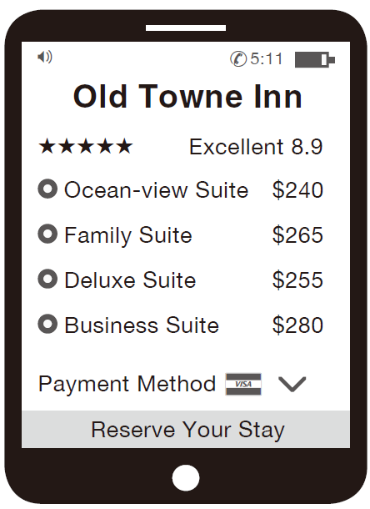
奠基篇 Unit 4
D
B
A
31. What is the purpose of the man’s visit?
(A) Pleasure
(B) Visiting family
(C) Class reunion
(D) Business
32. Why is the price not so important for the man?
(A) Exercise is more important.
(B) He is not paying the bill.
(C) It is close to his company.
(D) He needs good food.
33. Look at the graphic. How much does the man’s hotel room cost?
(A) $240
(B) $265
(C) $255
(D) $280

Slide 97
奠基篇 Unit 4
Audio Transcripts
Questions 31-33 refer to the following conversation and mobile website.
W: I’m looking forward to your visit next week. We could really use your help with the new product line. By the way, what hotel are you going to stay at?
M: I made a reservation at the Old Towne Inn. I got one of their best rooms on an upper floor. It’s expensive, but it looks nice.
W: The company is paying for it, so price doesn’t matter too much. That’s a tall building. You’ll be able to look down over the whole town from there!
M: Actually I’ll be on the other side, so I’ll be watching the waves—not the hustle and bustle of the town.
W: That’ll be pleasant. What made you choose that place?
M: I saw that it has an incredible Italian restaurant and an amazing fitness center. I figure that I can eat too much, but then go exercise.
• reservation (n.) 預約
• hustle and bustle 喧囂擾攘；熙熙攘攘 • fitness center 健身中心

Slide 98
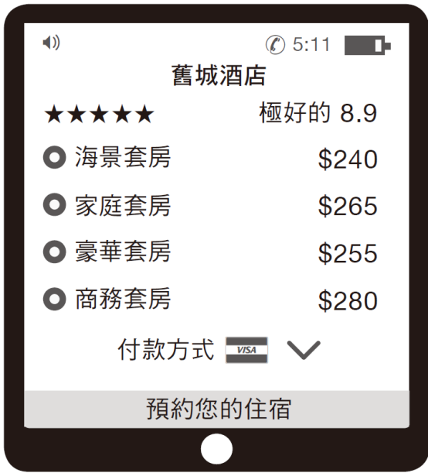
奠基篇 Unit 4
中文翻譯
女： 我期待你下星期的來訪，新的產品系列非常需要你的幫忙。對了，你要住在哪間飯店？
男： 我在舊城酒店訂了房間。那間房是他們最好的房間之一，樓層比較高。價錢很貴，不過看起來不錯。
女： 公司會付錢，所以價錢不是太重要。那棟建築很高。你從那裡可以俯瞰整座城市！
男： 事實上我會住在另一邊，所以我會看著海浪—而不是城裡喧囂的景象。
女： 那會很愉快。是什麼讓你選擇這個地方？
男： 我看到它有一間非常棒的義式餐廳和健身中心。我想我可以吃多一點，然後去運動一下。

Slide 99
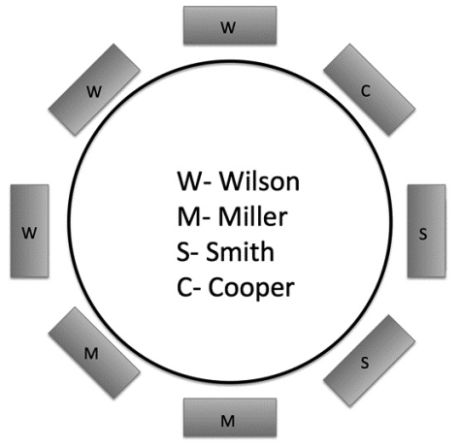
奠基篇 Unit 4
A
C
A
34. How does the woman feel about the Wilsons not attending the wedding?
(A) She is very upset about it.
(B) She doesn’t mind.
(C) She is glad they aren’t coming.
(D) She wants them to sit somewhere else.
35. What does the woman mean when she says, “we’ll make do”?
(A) We will have Allie sit next to the Millers.
(B) We will leave the seats empty.
(C) That’s the best we can do.
(D) There must be a better solution.
36. Look at the graphic. Whom will Allie Walker
sit next to?
(A) Mrs. Cooper and the Barbers
(B) The Wilsons and the Millers
(C) The Smiths and Mrs. Cooper
(D) The Millers and the Barbers

Slide 100
奠基篇 Unit 4
Audio Transcripts
Questions 34-36 refer to the following conversation and chart.
W: The Wilsons aren’t coming to the wedding. What actually irks me, though, is having to rearrange the seating. Who are we going to put at that table now?
M: Well, there’s no one else with a kid, so we’ll need a couple and a single, right?
W: I suppose so. How about the Barbers and Allie Walker?
M: That could work, but remember, Allie won’t sit next to the Millers.
W: She doesn’t have to. The Smiths still want to be next to old Mrs. Cooper.
M: Hmm . . . Well, we can’t just leave them empty. It’s not ideal, but . . .
W: Yeah, I suppose //we’ll make do.// As long as no one causes a fuss.
• irk (v.) 使厭倦；使苦惱 • fuss (n.) 抱怨

Slide 101

奠基篇 Unit 4
中文翻譯
女： 威爾森一家不能來參加婚禮。不過，令我感到厭煩的其實是要重新安排座位。現在我們要讓誰坐那桌呢？
男： 嗯，沒有其他人有小孩，所以我們需要一對夫妻和一位單身的人，對吧？
女： 我想是吧。巴柏夫妻和愛麗‧沃克如何？
男： 那樣可以，但要記住，愛麗不想坐在米勒夫妻的旁邊。
女： 她不用那樣。史密斯夫妻還是想坐在庫柏老太太旁邊。
男： 嗯……我們不能讓座位空著。那樣不盡理想，但……
女： 是啊，我想那是最好的做法了。只要沒有人抱怨。

Slide 102
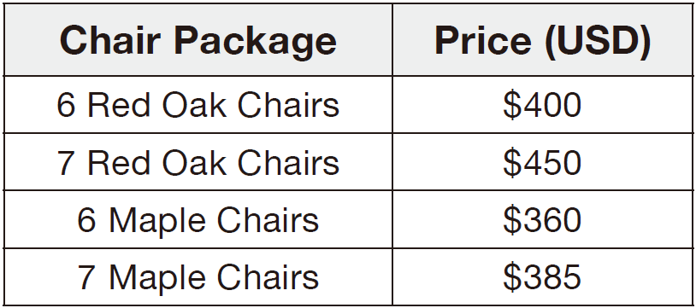
奠基篇 Unit 4
37. What was the conversation about?
(A) There was not enough money in the budget to get everyone a chair.
(B) John was being asked to order new chairs for the department.
(C) The woman had ordered too many chairs and had an extra one.
(D) The woman wanted to know how many people were in the department.
38. What was the woman’s preference for the order?
(A) She wanted to order 5 chairs.
(B) She only wanted to order a chair for herself.
(C) She wanted to order a chair for everyone, plus one extra.
(D) She did not specify any preference.
39. Look at the graphic. Which chair
package will John order?
(A) 6 Red Oak Chairs
(B) 7 Red Oak Chairs
(C) 6 Maple Chairs
(D) 7 Maple Chairs
B
C
D

Slide 103
奠基篇 Unit 4
Audio Transcripts
Questions 37-39 refer to the following conversation and chart.
W: John, we need some new office chairs for everyone in our department. Do you mind ordering them?
M: Not at all, what is our budget?
W: Four hundred dollars. The office supply store near us offers a deal when buying products in bulk. There are six of us in the department, but I would like to buy an extra chair, too.
M: OK, I will take a look at our options and see if an extra chair is possible with our budget.
W: Thank you for doing this for me.
M: Not a problem. I will e-mail you the receipt after placing the order.

Slide 104
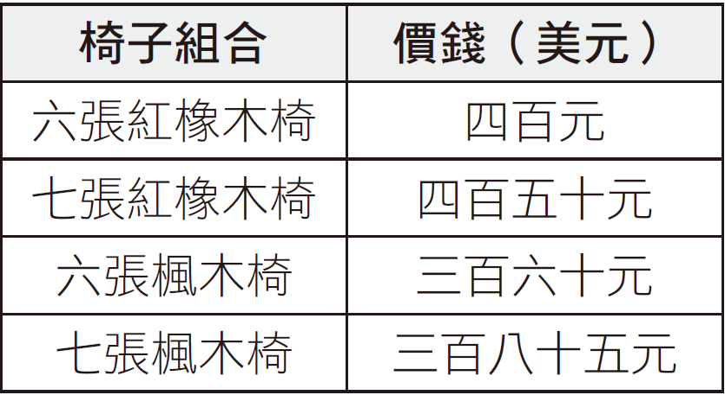
奠基篇 Unit 4
中文翻譯
女： 約翰，我們需要一些新的辦公椅給我們部門每位同仁。如果你不介意的話，可以去訂購嗎？
男： 不介意啊，我們的預算是多少？
女： 四百元。要是大量購買，我們附近的辦公用品店會提供優惠。我們部門有六個人，但我還想買一張額外的椅子。
男： 好的，我會看看我們有哪些選擇，看在預算內能不能買一張額外的椅子。
女： 謝謝你為我做這件事。
男： 沒問題。我訂貨之後會用電子郵件寄收據給妳。

Slide 105
奠基篇 Unit 4
Part 3 簡短對話
-The End-

